Slide 1
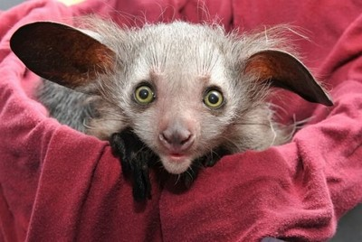
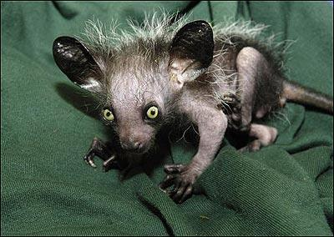
Palczak Madagascar

Slide 2
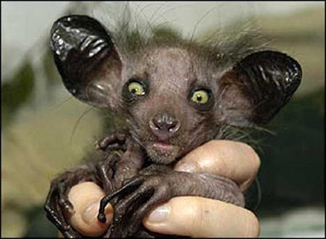
Species of prosimians, the only extant representative of the family palczakowatych closely related to more from him, extinct Daubentonia robusta.

Slide 3
There are about 20 - 25 years
Palczak Madagascar has a body the size of a cat, with a large head and a short snout, large ears, prehensile fingers and toes. Black and brown coloration on the face and around the breast lighter. Green-yellow eyes, big ears, fur fluffy with soft hair. Large fluffy tail. Weight 2-3 kg.

